Slide 1
Road ahead
Series Convergence Strategy (11.7)
Divergence Test (11.2)
Test p-series or geometric (11.2/3)
Comparison Test (11.4)
Alternating Series Test (11.5)
Ratio Test (11.6)
Root Test (11.6)
Integral Test (11.3)

Slide 2
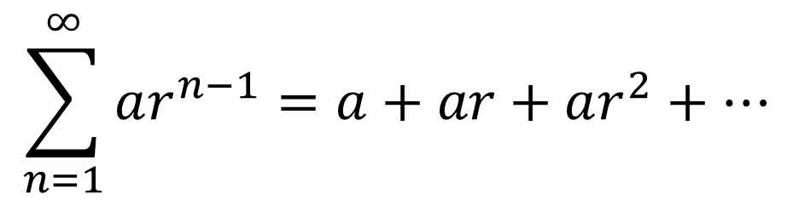
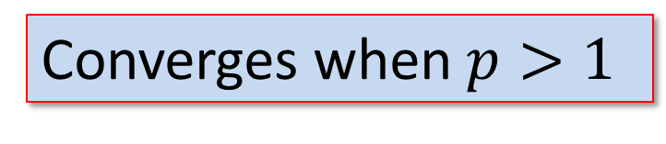
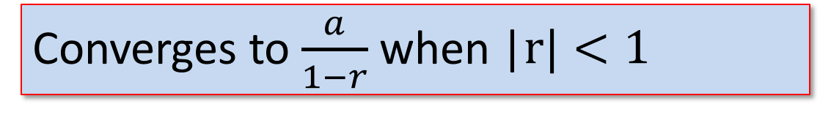
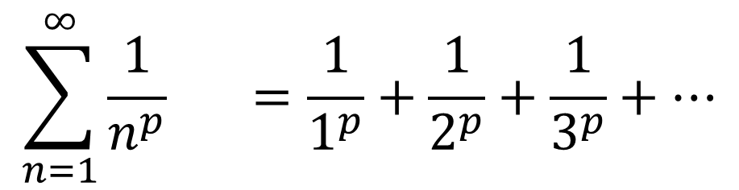
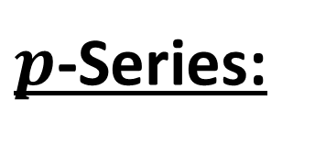
Review
$$\sum_{n=1}^{∞}{ar^{n−1}}=a+ar+ar^{2}+⋯$$
Geometric Series:
Converges to $\frac{a}{1−r}$ when |$r|<1$
$$\sum_{n=1}^{∞}{\frac{1}{n^{p}}} =\frac{1}{1^{p}}+\frac{1}{2^{p}}+\frac{1}{3^{p}}+⋯$$
$p$-Series:
Converges when $p>1$
Notes:
Remind students about constant multiples and sums

Slide 3
Math 152
Lesson | Topic | Reading
27 | Testing Series | 11.3/11.7
28 | Comparison tests/alternating series | 11.4/11.5
29 | Absolute Convergence, Ratio & Root Tests | 11.6
Objectives:
Understand difference between COMPARISON TEST & LIMIT COMPARISON TEST
Use Comparison, Limit Comparison, & Alternating Series Tests to prove convergence
Understand convergence/divergence of a series as it relates to the behavior of the series "in the long run"

Slide 4
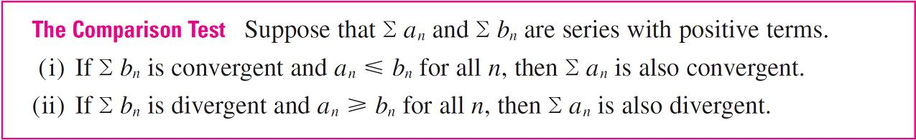
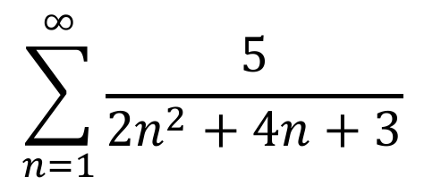
Comparison Test
Does the following series converge?
$$\sum_{n=1}^{∞}{\frac{5}{2n^{2}+4n+3}}$$
What could we compare it to?
Notes:
Examples from text, p723
Less than p-series with p=2
Greater than p-series with p=1 (looks a lot like “silver”)
Broken up into a p-series w/ p=.5 & a p-series w/ p=1.5: Div+Conv=Div

Slide 5
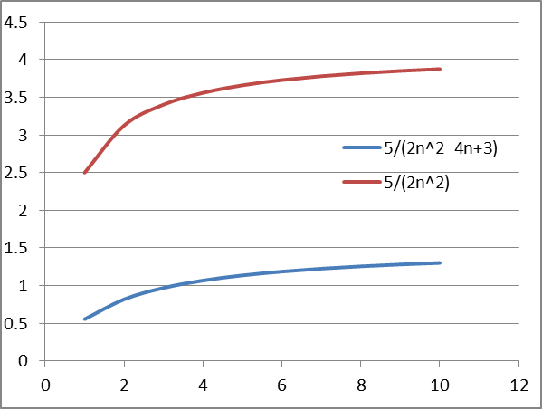
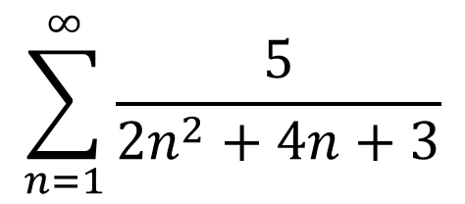
Example
$$\sum_{n=1}^{∞}{\frac{5}{2n^{2}+4n+3}}$$
p-series with p > 1, convergent; therefore, the original is convergent
Notes:
Or, compare to 1/n^2, which is a convergent p-series (p>1)

Slide 6
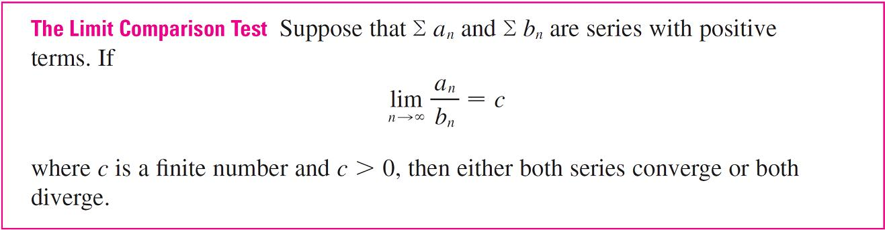
The Comparison Tests
Test the series for convergence or divergence.

Slide 7
Example
Test the series for convergence or divergence.
Solution:
Since this limit exists and Σ 1/2^{n} is a convergent geometric series, the given series converges by the Limit Comparison Test.

Slide 8
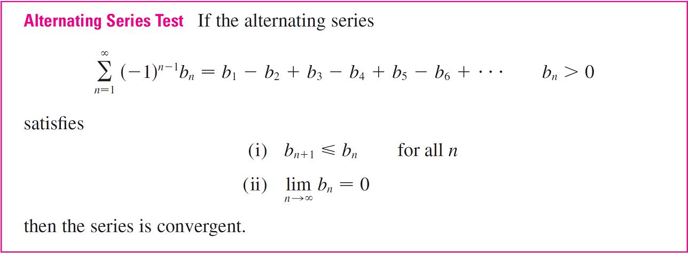
Alternating Series
If the abs of the sequence decrease and limit is 0,
then the series converges

Slide 9
Example
The alternating harmonic series
satisfies
(i) b_{n + 1} < b_{n}
(ii)
so the series is convergent by the Alternating Series Test.

Slide 10
Integral Test Review
Positive, decreasing, & continuous

Slide 11
Integral Test Review

Slide 12
Integral Test Review

Slide 13
Integral Test Review

Slide 14
Desk Work
Use comparison or alternating test

Slide 15
Answers

Slide 16
Backups

